Slide 1

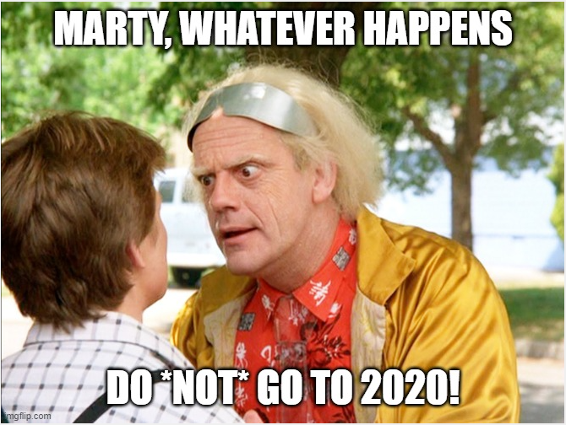

Burnout
more than just a bad day!
Seth Petry-Johnson

Slide 2
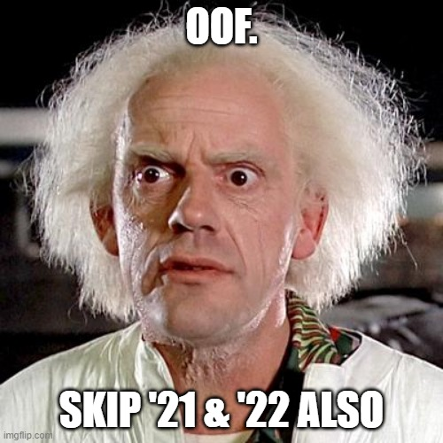
Burnout
more than just a bad day!
Seth Petry-Johnson
Notes:
Welcome to my talk on burnout.
I want to set the stage for this session by taking you on a brief trip backwards through time to 2020.
You might recall that it was a fairly stressful time between the pandemic and the politics and all the upheaval in the workplace. Lots of people were stressed out by being forced to suddenly work from home, whether or not they wanted to do so or had an area of their home that was conducive for work.
Other people, like myself, were already working from home and were used to it, so that part wasn’t stressful. But we weren’t necessarily used to sharing our nice, clean, quiet homes with the kids and spouses that were suddenly there all day long, every single day. I love my family, but getting used to their noise and their messes and their constant presence was stressful for me.
And don’t even get me started on remote learning; anyone that’s put an ADHD third grader through virtual school while working their own full-time job deserves combat pay, in my opinion.

Slide 3
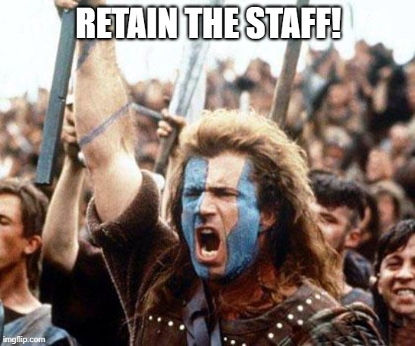
Burnout
more than just a bad day!
Seth Petry-Johnson
Notes:
Skip forward to 2021 and things aren’t necessarily getting better, but at least we’re getting used to the new normal. Maybe instead of spending every day wearing dirty sweatpants and eating ice cream in bed, we’re only doing it every other day.
That’s progress, but still a long way from “good”.
At work, my company was starting to feel the impact of all that stress. People were grumpy, productivity was suffering, and we were facing a turnover crisis. Someone would leave, which increased the workload on those that were left. The remaining people were also burned out and didn’t have the mental energy to handle the increased workload, and they would before we could fully train the first person’s replacement. This was turning into a vicious cycle that was really hurting our business.

Slide 4
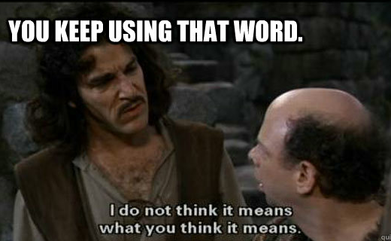
Burnout
more than just a bad day!
Seth Petry-Johnson
Notes:
In response, we set a major organizational goal for 2021 to stop the attrition and to retain our staff.
This was a key focus at all layers of management, and as we went through a process of discovery and analysis, we kept hearing people talk about being “used up” or “burned out”.

Slide 5
Burnout
more than just a bad day!
Seth Petry-Johnson
Today’s agenda
Understanding burnout
Diagnosing and measuring burnout
Treating / managing burnout
Notes:
But when we tried to drill in, no one quite explained or thought about burnout quite the same way.
It was a bit like the Supreme Court and pornography; everyone was certain they could identify burnout when they saw it or were feeling it, but couldn’t quite define it in way that told us how to treat it.
So, I decided to do some research into burnout. I wanted to know more about what caused it, whether there was any standard way of measuring it, and what we could do to recover from it.

Slide 6

Burnout
more than just a bad day!
Seth Petry-Johnson
Employed Americans w/ no ideas for reducing burnout
1 in 10
Today’s agenda
Understanding burnout
Diagnosing and measuring burnout
Treating / managing burnout
Notes:
And that brings us to today’s agenda.
This session is a summary of what I learned during that research and how I used that knowledge to quantitatively measure the burnout in my organization. I’ll show you how easy it is to measure burnout on your own teams, and how to use those measurements to guide your treatment strategy.

Slide 7
Burnout
more than just a bad day!
Seth Petry-Johnson
Understanding burnout
Employed Americans reporting worker burnout
Today’s agenda
Diagnosing and measuring burnout
76%
Treating / managing burnout

Slide 8
Burnout
more than just a bad day!
Seth Petry-Johnson
Understanding burnout
Employed Americans reporting complete burnout
9%

Slide 9
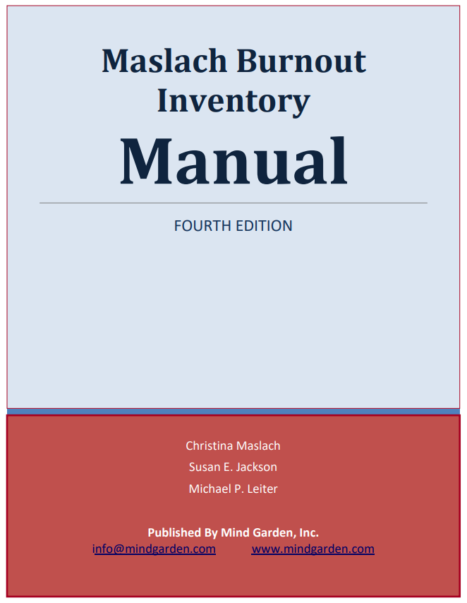
Burnout
more than just a bad day!
Seth Petry-Johnson
Understanding burnout
Employed Americans w/ no ideas for reducing burnout
1 in 10

Slide 10
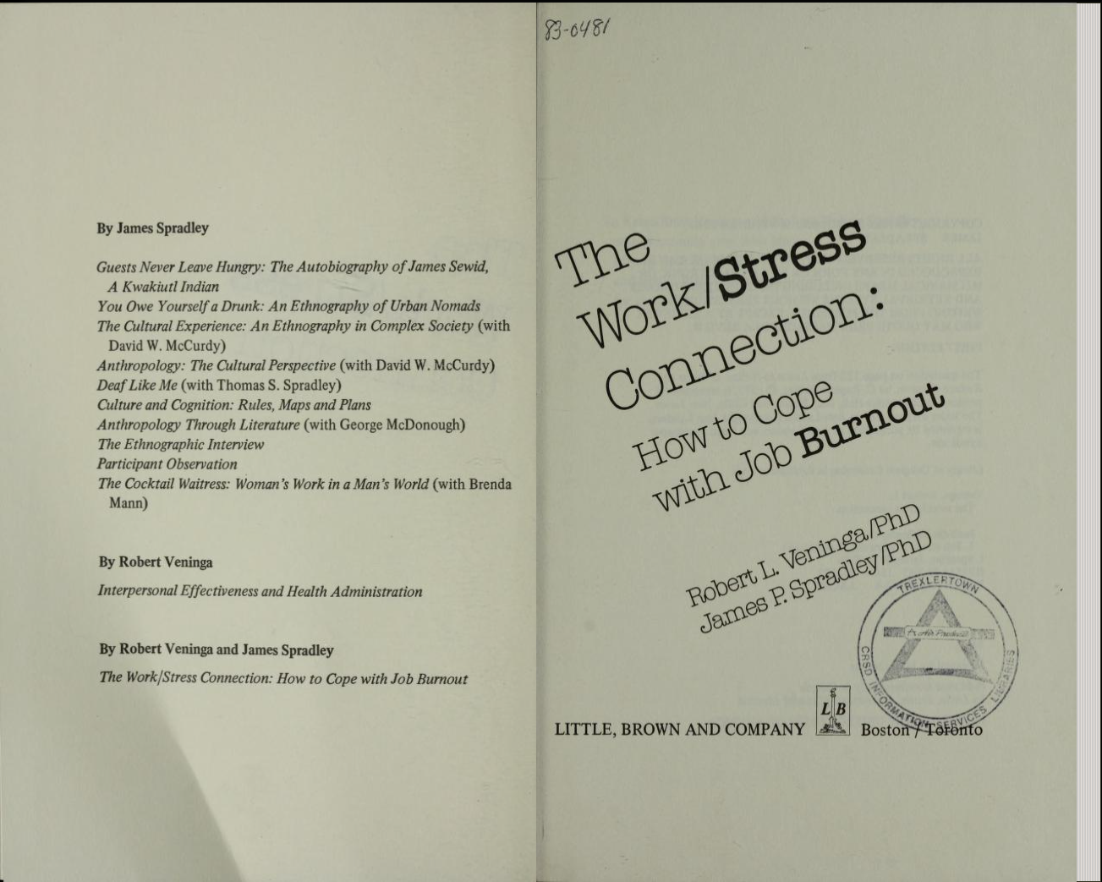
Burnout
more than just a bad day!
Seth Petry-Johnson
Understanding burnout
Employed Americans w/ no ideas for reducing burnout
1 in 10

Slide 11
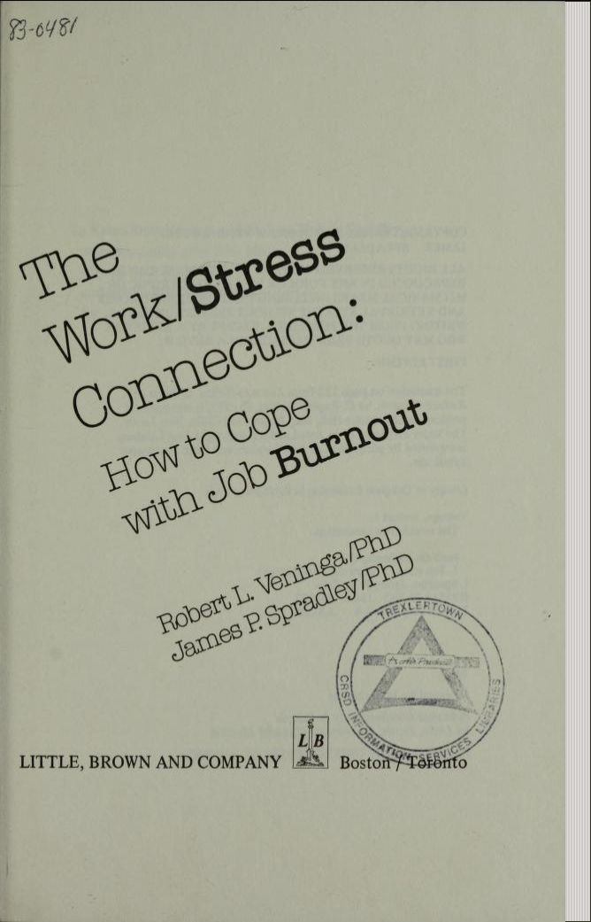
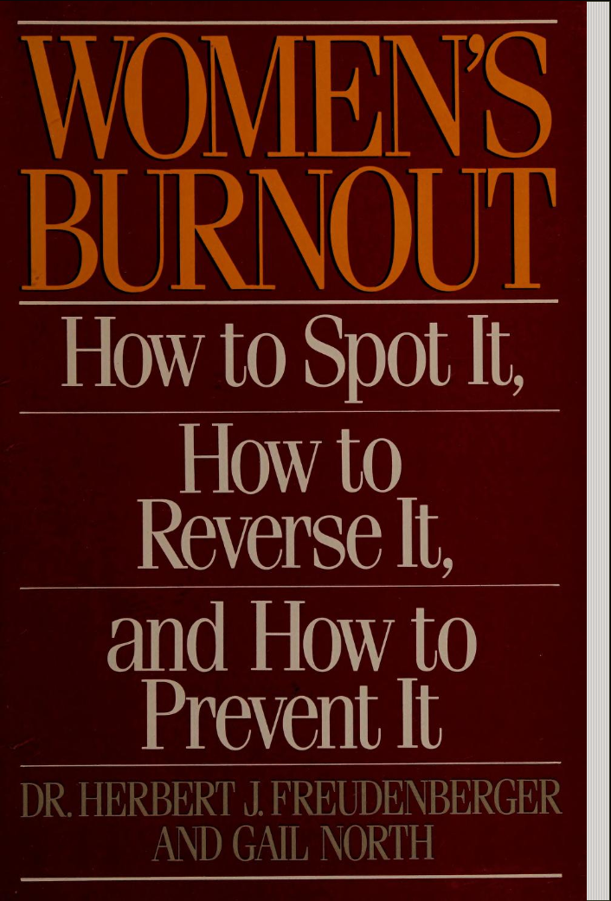
Burnout
more than just a bad day!
Seth Petry-Johnson
Understanding burnout

Slide 12
Burnout
more than just a bad day!
Seth Petry-Johnson
Understanding burnout

Slide 13
Burnout
more than just a bad day!
Seth Petry-Johnson
Understanding burnout
Burnout is a syndrome,
not a specific diagnosis

Slide 14
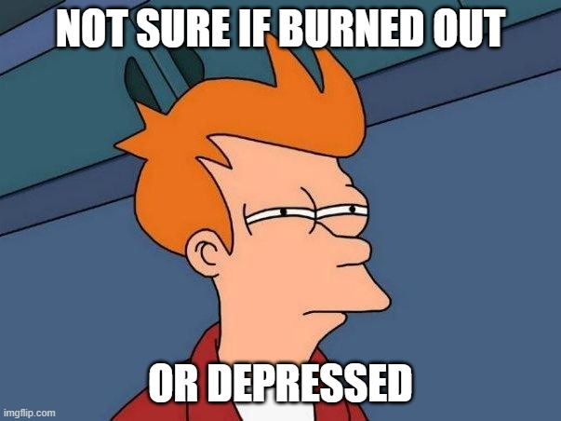
Burnout
more than just a bad day!
Seth Petry-Johnson
Understanding burnout
Burnout is a syndrome,
not a specific diagnosis
A syndrome is a group of symptoms that consistently occur together
Veninga and Spradley 5 stages

Slide 15

Burnout
more than just a bad day!
Seth Petry-Johnson
Understanding burnout
Burnout is a syndrome,
not a specific diagnosis
A syndrome is a group of symptoms that consistently occur together
Veninga and Spradley 5 stages

Slide 16
Burnout
more than just a bad day!
Seth Petry-Johnson
Understanding burnout
Burnout is a syndrome,
not a specific diagnosis
A syndrome is a group of symptoms that consistently occur together
Veninga and Spradley 5 stages
Burnout symptoms accompany chronic unmanaged stress
in the workplace

Slide 17


Burnout
more than just a bad day!
Seth Petry-Johnson
Veninga and Spradley 5 stages of workplace burnout
Honeymoon
High job satisfaction
Commitment / energy / creativity
Stress feels like “good stress”; we don’t recognize adaptation energy being used up

Slide 18

Burnout
more than just a bad day!
Seth Petry-Johnson
Veninga and Spradley 5 stages of workplace burnout
Fuel Shortage
Honeymoon
Begin to overdraw adaptation energy
Vague feeling of loss
“Balancing act”

Slide 19

Burnout
more than just a bad day!
Seth Petry-Johnson
Veninga and Spradley 5 stages of workplace burnout
Fuel Shortage
Chronic Symptoms
Honeymoon
Chronic exhaustion
Physical illness
Anger / depression

Slide 20

Burnout
more than just a bad day!
Seth Petry-Johnson
Symptoms become critical
Pessimism and self-doubt
“Escape mentality”
Veninga and Spradley 5 stages of workplace burnout
Fuel Shortage
Chronic Symptoms
Honeymoon
Crisis

Slide 21
Burnout
more than just a bad day!
Seth Petry-Johnson
Veninga and Spradley 5 stages of workplace burnout
Burnout transitions into significant and persistent physical or emotional problems
Fruedenberger’s 12 stages
Fuel Shortage
Chronic Symptoms
Hitting the Wall
Honeymoon
Crisis

Slide 22
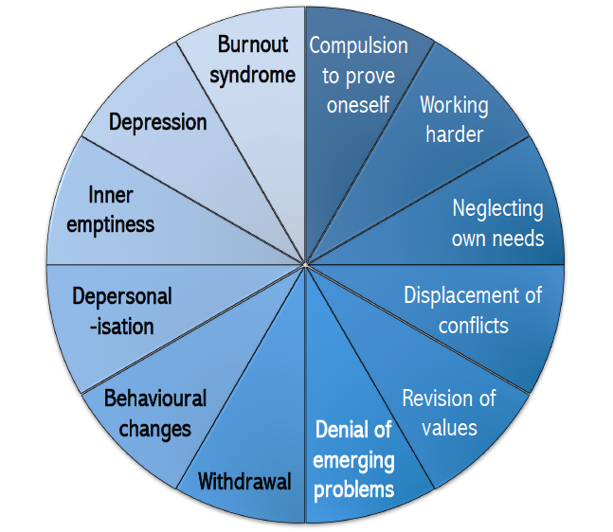
Burnout
more than just a bad day!
Seth Petry-Johnson
Veninga and Spradley 5 stages of workplace burnout
Fruedenberger’s 12 stages
Hitting the Wall
Honeymoon
→
Maslach Burnout Inventory 3 scales for measuring burnout

Slide 23

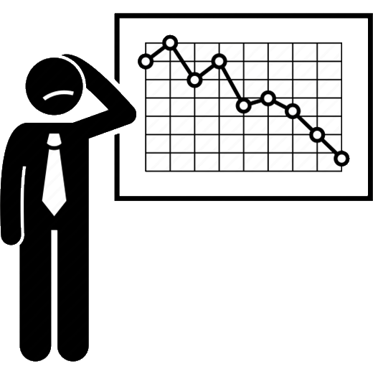
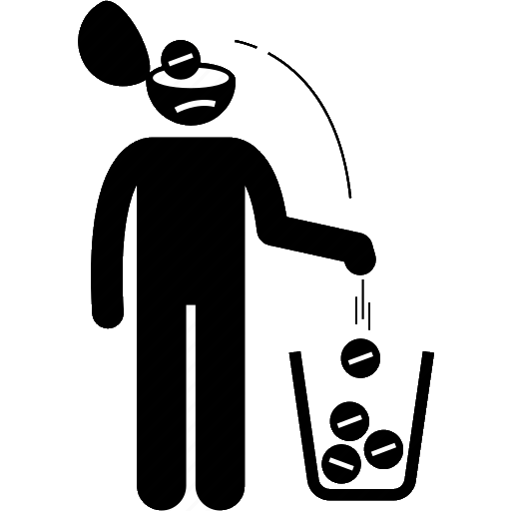
Burnout
more than just a bad day!
Seth Petry-Johnson
Veninga and Spradley 5 stages of workplace burnout
Maslach Burnout Inventory 3 scales for measuring burnout
Fruedenberger’s 12 stages
Hitting the Wall
Honeymoon
→
Exhaustion
Low Professional Efficacy
Cynicism

Slide 24
Burnout
more than just a bad day!
Seth Petry-Johnson
Maslach Burnout Inventory 3 scales for measuring burnout
Feelings related to work, not symptoms
Low Professional Efficacy
Exhaustion
Cynicism
Worn out by work
Energized by work
My work doesn’t matter
My work is valuable

Slide 25
Burnout
more than just a bad day!
Seth Petry-Johnson
Maslach Burnout Inventory 3 scales for measuring burnout
Measured on a spectrum
Low Professional Efficacy
Exhaustion
Cynicism
Worn out by work
Energized by work
My work doesn’t matter
My work is valuable

Slide 26
Burnout
more than just a bad day!
Seth Petry-Johnson
Maslach Burnout Inventory 3 scales for measuring burnout
Measured on a spectrum
Low Professional Efficacy
Exhaustion
Cynicism
Worn out by work
Energized by work
My work doesn’t matter
My work is valuable
I’m not good at my job
I make a difference

Slide 27
Burnout
more than just a bad day!
Seth Petry-Johnson
Maslach Burnout Inventory 3 scales for measuring burnout
Measured on a spectrum
Low Professional Efficacy
Exhaustion
Cynicism
Worn out by work
Energized by work
My work doesn’t matter
My work is valuable
I’m not good at my job
I make a difference

Slide 28


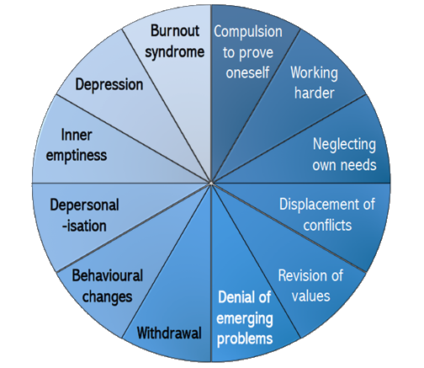

Burnout
more than just a bad day!
Seth Petry-Johnson
3 models of burnout
Low Professional Efficacy
Exhaustion
3 separate feelings
Progressively worsening symptoms
Worn out by work
Energized by work
I’m not good at my job
I make a difference
Cynicism
My work doesn’t matter
My work is valuable

Slide 29
Burnout
more than just a bad day!
Seth Petry-Johnson
Measuring burnout
Progressively worsening symptoms
Worn out by work
Energized by work

Slide 30
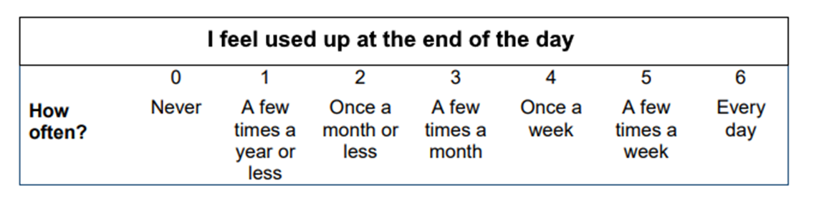
Burnout
more than just a bad day!
Seth Petry-Johnson
Measuring burnout
Burnout Inventory
Areas of Worklife Survey
Measures 3 types of feelings to
provide a burnout “score”
Suggests reasons for burnout due to mismatch w/ key aspects of job/role
Exhaustion

Slide 31
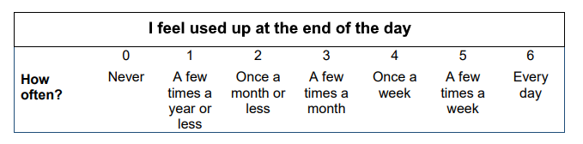
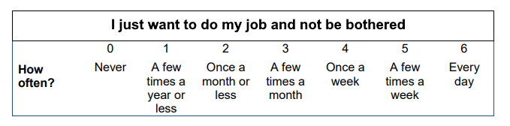
Burnout
more than just a bad day!
Seth Petry-Johnson
Measuring burnout
Areas of Worklife Survey
Suggests reasons for burnout due to mismatch w/ key aspects of job/role
Exhaustion
Burnout Inventory
Measures 3 types of feelings to provide a burnout “score”
Cynicism

Slide 32
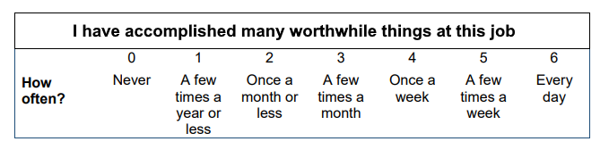
Burnout
more than just a bad day!
Seth Petry-Johnson
Measuring burnout
Exhaustion
Cynicism
Burnout Inventory
Measures 3 types of feelings to provide a burnout “score”
Professional Efficacy

Slide 33
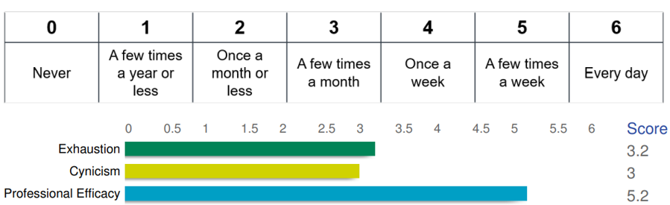
Burnout
more than just a bad day!
Seth Petry-Johnson
Measuring burnout
Exhaustion
Cynicism
Burnout Inventory
Measures 3 types of feelings to provide a burnout “score”
Professional Efficacy

Slide 34
Burnout
more than just a bad day!
Seth Petry-Johnson
Measuring burnout
Exhaustion
Cynicism
Burnout Inventory
Measures 3 types of feelings to provide a burnout “score”
Professional Efficacy

Slide 35
Burnout
more than just a bad day!
Seth Petry-Johnson
Measuring burnout
Burnout Inventory
Measures 3 types of feelings to provide a burnout “score”
For Exhaustion and Cynicism,
higher numbers contribute to burnout

Slide 36
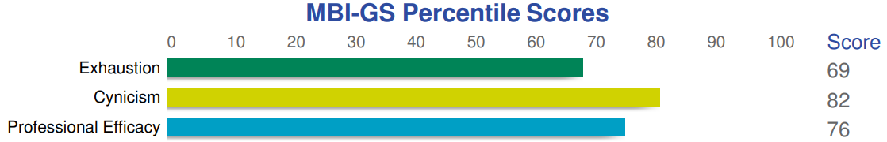
Burnout
more than just a bad day!
Seth Petry-Johnson
Measuring burnout
Burnout Inventory
Measures 3 types of feelings to provide a burnout “score”
For Professional Efficacy,
Lower numbers contribute to burnout

Slide 37
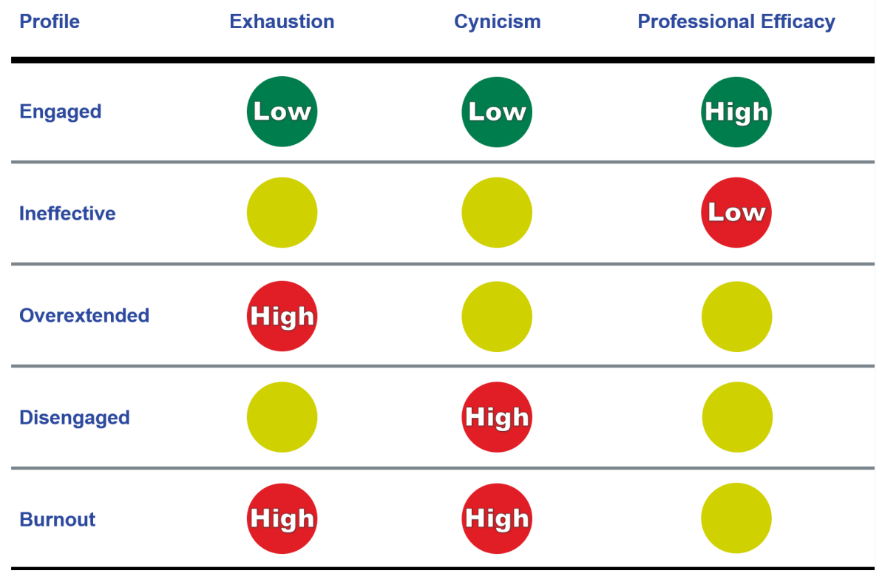
Burnout
more than just a bad day!
Seth Petry-Johnson
Measuring burnout
Percentage of people experiencing this feeling with less frequency than respondent
For Professional Efficacy,
Lower numbers contribute to burnout
Burnout Inventory
Measures 3 types of feelings to provide a burnout “score”

Slide 38
Percentage of people experiencing this feeling with less frequency than respondent
Burnout
more than just a bad day!
Seth Petry-Johnson
Measuring burnout
Good scores across all 3 scales
Burnout Inventory
Measures 3 types of feelings to provide a burnout “score”

Slide 39
Burnout
more than just a bad day!
Seth Petry-Johnson
Measuring burnout
Burnout Inventory
Measures 3 types of feelings to provide a burnout “score”
One primary driver of burnout

Slide 40
Burnout
more than just a bad day!
Seth Petry-Johnson
Measuring burnout
Burnout Inventory
Measures 3 types of feelings to provide a burnout “score”
Two primary drivers of burnout

Slide 41
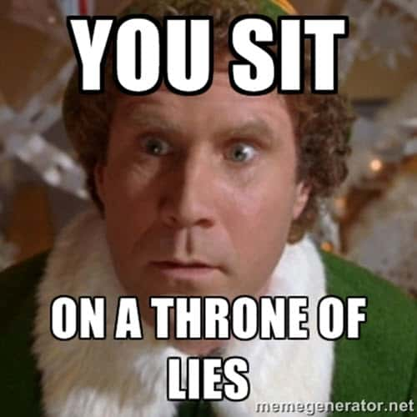

Burnout
more than just a bad day!
Seth Petry-Johnson
Measuring burnout
Burnout Inventory
Measures 3 types of feelings to provide a burnout “score”
Two primary drivers of burnout

Slide 42
Burnout
more than just a bad day!
Seth Petry-Johnson
Measuring burnout
The reliability of the three MBI scales exceeds recommended levels for research studies
The validity of the MBI has been demonstrated by numerous studies
Burnout Inventory
Measures 3 types of feelings to provide a burnout “score”
Two primary drivers of burnout

Slide 43
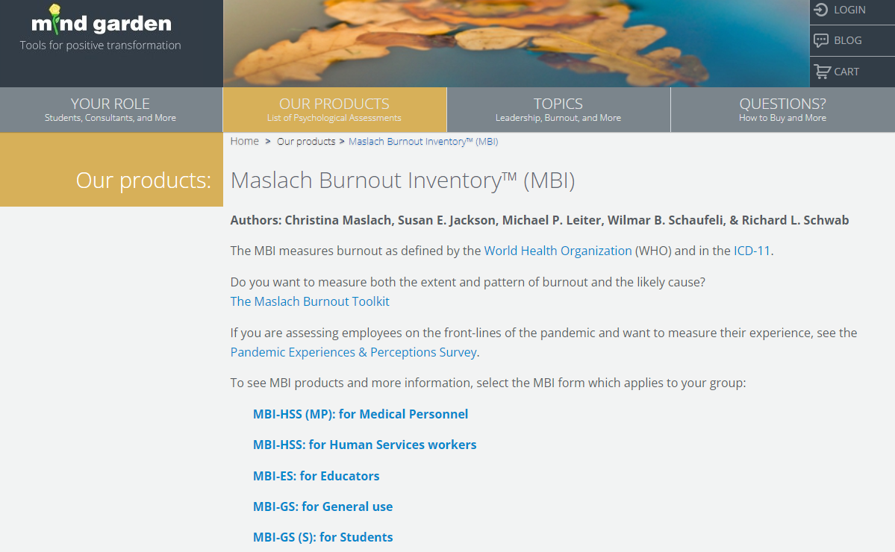
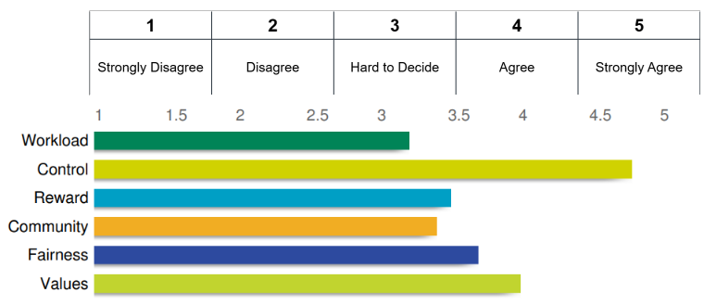
Burnout
more than just a bad day!
Seth Petry-Johnson
Measuring burnout
The reliability of the three MBI scales exceeds recommended levels for research studies
The validity of the MBI has been demonstrated by numerous studies
Burnout Inventory
Measures 3 types of feelings to provide a burnout “score”
Areas of Worklife Survey
Suggests reasons for burnout due to mismatch w/ key aspects of job/role

Slide 44
The reliability of the three MBI scales exceeds recommended levels for research studies
The validity of the MBI has been demonstrated by numerous studies
Burnout Inventory
Measures 3 types of feelings to provide a burnout “score”
Burnout
more than just a bad day!
Seth Petry-Johnson
Measuring burnout
Areas of Worklife Survey
Suggests reasons for burnout due to mismatch w/ key aspects of job/role

Slide 45
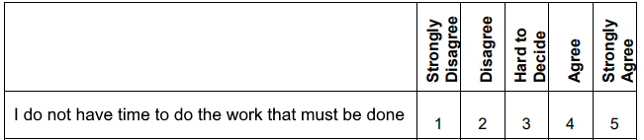
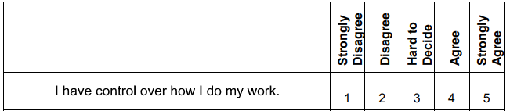
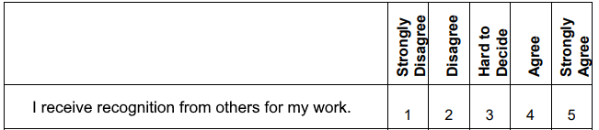
Burnout
more than just a bad day!
Seth Petry-Johnson
Measuring burnout
Exhaustion
Control
Areas of Worklife Survey
Suggests reasons for burnout due to mismatch w/ key aspects of job/role
Reward

Slide 46
Burnout
more than just a bad day!
Seth Petry-Johnson
Rolling out the MBI to your team
Areas of Worklife Survey
Suggests reasons for burnout due to mismatch w/ key aspects of job/role

Slide 47
Burnout
more than just a bad day!
Seth Petry-Johnson
Rolling out the MBI to your team
MindGarden.com

Slide 48




Burnout
more than just a bad day!
Seth Petry-Johnson
Rolling out the MBI to your team
MindGarden.com
Burnout Inventory Manual
$50.00 – Only need 1
Transform Survey Hosting
$2.50 per person
Individual Report
$2.50 per person
Group Report
$200 per report

Slide 49
Burnout
more than just a bad day!
Seth Petry-Johnson
Rolling out the MBI to your team
Burnout Inventory Manual
$50.00 – Only need 1
Transform Survey Hosting
$2.50 per person
Individual Report
$2.50 per person
Group Report
$200 per report
MindGarden.com

Slide 50
Burnout
more than just a bad day!
Seth Petry-Johnson
Rolling out the MBI to your team
Burnout Inventory Manual
$50.00 – Only need 1
Required
Transform Survey Hosting
$2.50 per person
Individual Report
$2.50 per person
Group Report
$200 per report
MindGarden.com

Slide 51
Burnout
more than just a bad day!
Seth Petry-Johnson
Rolling out the MBI to your team
Burnout Inventory Manual
$50.00 – Only need 1
Required
Transform Survey Hosting
$2.50 per person
Individual Report
$2.50 per person
Pick one (or both)
Group Report
$200 per report
MindGarden.com

Slide 52
Burnout
more than just a bad day!
Seth Petry-Johnson
Rolling out the MBI to your team
Burnout Inventory Manual
$50.00 – Only need 1
Transform Survey Hosting
$2.50 per person
Total cost for my 25 person company was $xxx
Individual Report
$2.50 per person
Group Report
$200 per report
MindGarden.com

Slide 53
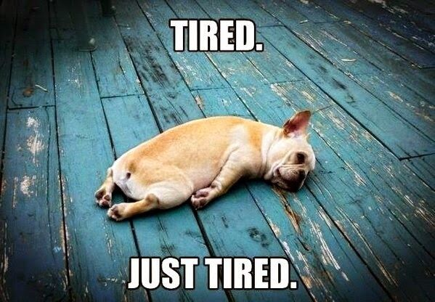
Burnout
more than just a bad day!
Seth Petry-Johnson
Understanding burnout
Burnout symptoms:
Depleted energy reserves
Pervasive feeling of exhaustion

Slide 54
Burnout
more than just a bad day!
Seth Petry-Johnson
Understanding burnout
Burnout symptoms:
Depleted energy reserves
Hard to get out of bed in the morning

Slide 55
Burnout
more than just a bad day!
Seth Petry-Johnson
Understanding burnout
Burnout symptoms:
Depleted energy reserves
Loss of interest in leisure activities

Slide 56
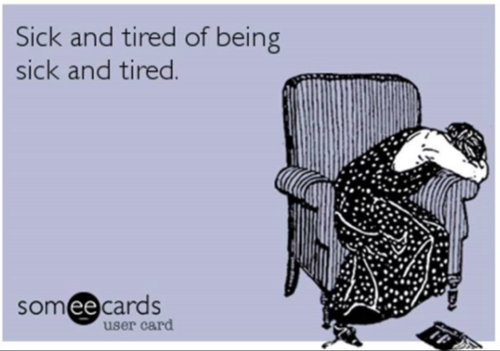
Burnout
more than just a bad day!
Seth Petry-Johnson
Understanding burnout
Burnout symptoms:
Depleted energy reserves
Withdrawal from relationships /
“No fun to be around”

Slide 57
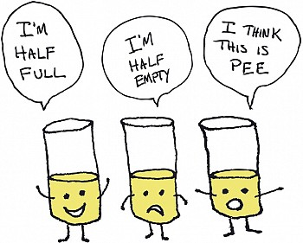
Burnout
more than just a bad day!
Seth Petry-Johnson
Understanding burnout
Burnout symptoms:
Depleted energy reserves
Lowered resistance to illness

Slide 58
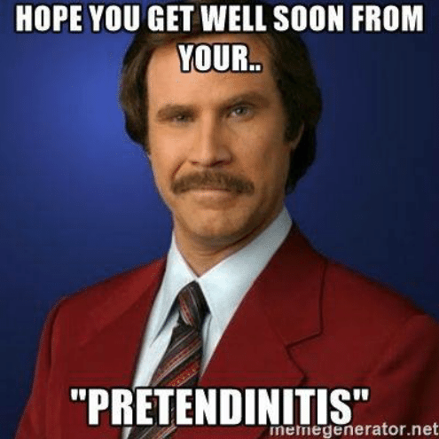
Burnout
more than just a bad day!
Seth Petry-Johnson
Understanding burnout
Burnout symptoms:
Depleted energy reserves
Lowered resistance to illness
Increased dissatisfaction and pessimism

Slide 59
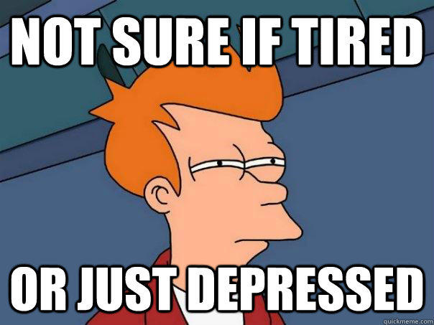
Burnout
more than just a bad day!
Seth Petry-Johnson
Understanding burnout
Burnout symptoms:
Depleted energy reserves
Lowered resistance to illness
Increased dissatisfaction and pessimism
Increased absenteeism and inefficiency at work

Slide 60
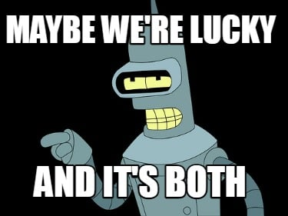
Burnout
more than just a bad day!
Seth Petry-Johnson
Understanding burnout
Burnout symptoms:
Depleted energy reserves
Lowered resistance to illness
Increased dissatisfaction and pessimism
Increased absenteeism and inefficiency at work

Slide 61
Burnout
more than just a bad day!
Seth Petry-Johnson
Understanding burnout
Burnout is a syndrome of three types of feelings:
Emotional exhaustion
Depersonalization
Low personal accomplishment

Slide 62

Burnout
more than just a bad day!
Burnout is a state of
emotional, physical, and mental exhaustion
caused by excessive and prolonged stress
Today’s agenda
Understanding burnout
Diagnosing and evaluating burnout
Treating / managing burnout

Slide 63
Burnout
more than just a bad day!
Burnout is a state of
emotional, physical, and mental exhaustion
caused by excessive and prolonged stress
Pandemic
Inflation
Politics
Job insecurity
Family stress
WFH / RTO
Adulting
Turnover

